Slide 1
Bohol Vision Sharing
March 2018

Slide 2
Why Bohol?
Chosen End Times Location
Idolatry has left a curse on the land
Revival, if they accept it, will make history
Place for end times Equipping & Training
Blessings Withheld, will be released suddenly
Economic Development will reveal God’s goodness

Slide 3
Revival
Our Main objective
My Main task
Our only eternal objective
Will overthrow current order, establish miracles and righteousness as normal
All projects relate back to this objective somehow, even if not obvious

Slide 4
Revival
New move of God, will upset old order
Foundations of the Kingdom will change what ministry and church life look like
Communion (fellowship) will be common
Miracles, Angels, Baptism of Fire, Worship
People will come from all over the world to experience it

Slide 5
Projects
Income Making projects
Tourism, Hospitality, Sports
Manufacturing, gives jobs
Charity projects, care for needy
Housing, real estate development
ALL Media: printed, movies, music
Direct Ministry Projects

Slide 6
Projects
Projects affect revival, help to support and fund it
Some merely bring a lot of happiness or comfort to people
Some are very practical and utilitarian giving jobs or making things
The projects have no eternal value, only souls and the effect on people's souls is what endures.

Slide 7
Projects
Planning many years already
A great many details shown by God,
it is a BURDEN people do not understand
God said, Yes we will do ALL THESE THINGS … BUT SO WHAT?!
End Times …. Fate of our projects?
Always remind yourself, it’s the PEOPLE we need to affect

Slide 8
Short List of Projects
Bethsaida Fish Farm
Ambassador Hotel, and Others
Sympatico Theme Park
New Town “Gloria”
Bohol Christian University (BCU)
Golden Days Care (100ha),
Children’s village (100ha),
Shepherd’s Haven
Manufacturing, Construction, Hardware

Slide 9
Housing, Retail, Restaurants
Shipping, Horses, Farming
ALL Media: TV, Radio, Movies, Websites, book publishing, magazines, Apps, DVD’s, Event Production (sports)
Ministry:
  Retreat center, outreach teams, overseas mission bases, local training campus, Pastor’s network, church planting, Prophetic equipping and training in healing
  Revival coming will be legendary
… and more

Slide 10
First Steps: Prayer, Intercession
Unseen activity to most people
Holy Spirit moved to give burdens and visions to MANY people
Angels released to prepare the land
Prophecy led to Prayer that laid the first foundations that we see or know of
Spiritual warfare, removing principality (religion), fighting witches, planting seeds. Etc.
Things already in motion before its visible

Slide 11
First Big Visible Projects
Bethsaida Fish Farm
SUPPORT PROJECTS to make it possible
  TK- Construction
  DIY – Hardware Store
  Fortress – Prefab Concrete
Planning Department & Design Team
Ministry and Charity on-going--busy!!
Other projects as we like, eg, Horses

Slide 12
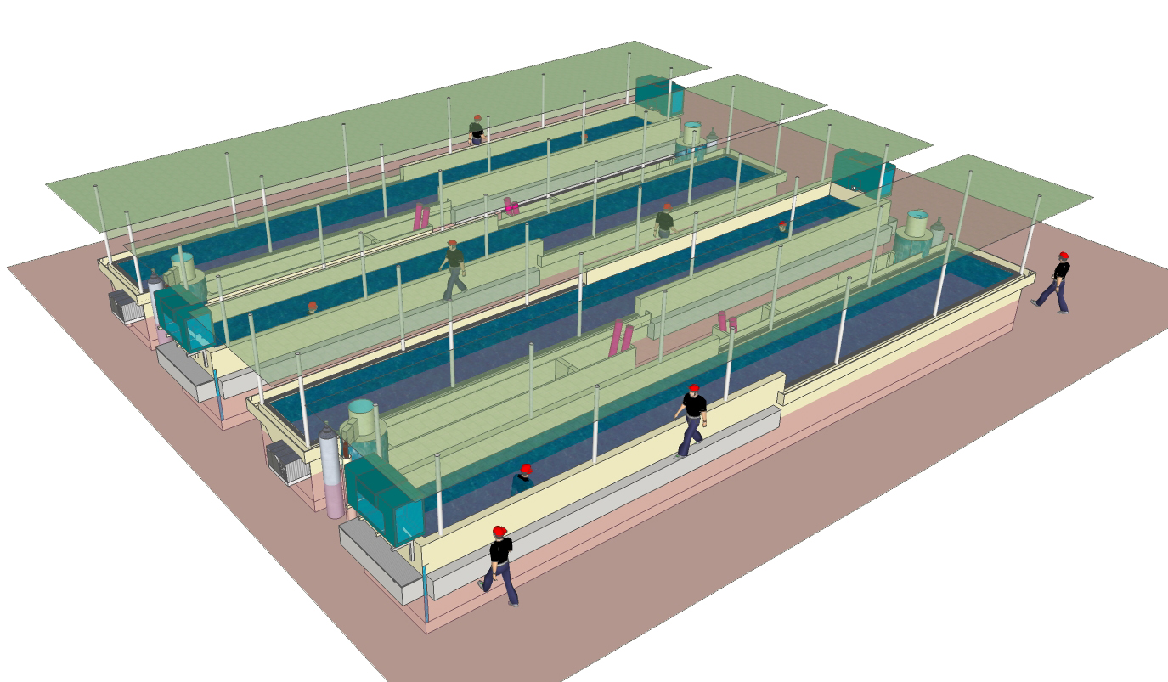
Bethsaida: Grow Out Tanks

Slide 13
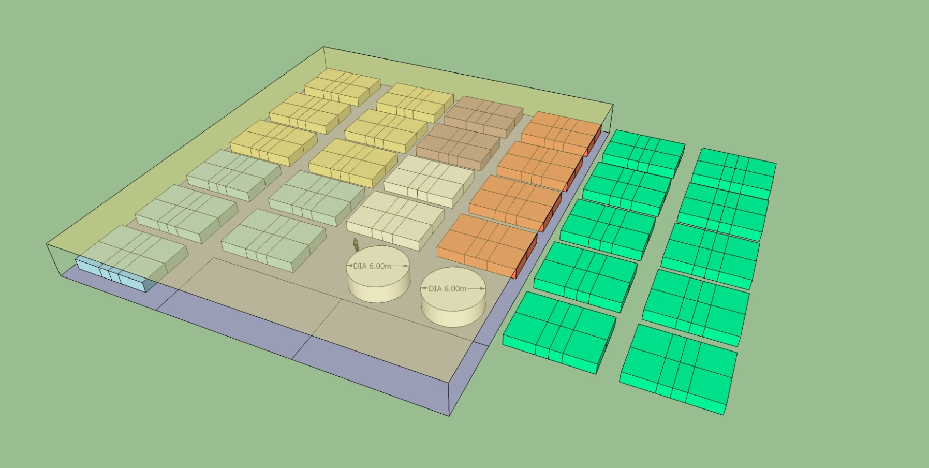
Bethsaida: Nursery & Algae

Slide 14
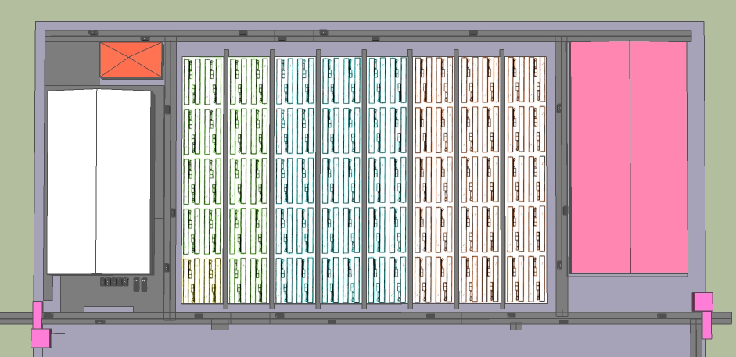
Bethsaida: Full Farm Layout

Slide 15
Bethsaida
Jesus said to name it Bethsaida, said to grow RED Lapu Lapu and sell live to Hong Kong
Jesus said to make fish tanks 20m x 2m long and fill TWO HECTARES of this
He said fish will grow to 1kg size in less than 14 months, and first shipment at 9-12months of 0.5kg fish 31tons earns HK$19m
We will grow 1-1.5 million eggs/month, need live breeding stock, kept at sea until farm is ready

Slide 16
Bethsaida
Pellet Feed is main cost, gives us FCR of 1:1.5 -- 1kg fish uses 1.5 kg of feed
Feed costs <30p/kg, 1kg fish feed costing 50p … 1 kg sells for HK$615 (P4,000)
Elec cost, each tank uses P12k/mo; 30-50 tanks in phase 1; this is 170kW/hr or P600k/mo, need genset backup & fuel
Staff cost, 50 people, some technical, all need training in BFAR, SEAFDEC, etc

Slide 17
Bethsaida
Each tank grows 7,500 kg in 14 months (5,000 kg to 0.5kg size at 8 months, harvest HALF, then grow out others until 1kg 14 months)
Each tank in 14months makes 7,500kg, uses 12 ton or P360k of feed, earns HK$4.6m (P30m) (have 100+100 tanks)
We bring 4-12 tanks to market each month
4 tanks would earn P120m 12 tanks would earn P360m,

Slide 18
Bethsaida
Other Facilities: Nursery w/ laboratory, work area, office, canteen, bunk houses
Tanks: egg, larva, fry, fingerling, growout, broodstock, algae, seawater in resrvoir
Utilities, elec, fresh water, seawater in, etc.
Feed Mill (Susan Besas) off site
Importing pumps, rebar, equipment, etc. means dealing with CUSTOMS

Slide 19
Bethsaida
Have found land, will need to prepare it
Need permits for fish collection, water pipeline in, 100% export company but will be WOS of ministry charity foundation I think
Investment of USD$1 million will enable many other side projects, ministry, farming and trade. Will earn back 2x in 12 months,
Will AMASS LARGE SAVINGS QUICKLY

Slide 20
Other Start Up Phase Projects
We will increase MINISTRY as soon as we have budget: Bible school, Outreaches, etc.
This also includes Websites: (Gazette, Facebook for Prophets: Gracebook, etc.)
And a RETREAT in Carmen God said.
He also said … make Ambrose Equestrian
Also need Plant Nursery for Theme Park
Also Farm in Balilihan for Chicken, Veggies, Herbs, etc. (same as plant nursery? Ranch?)
What about Radio Station, Pizza Resto, etc?

Slide 21
What Next?
Planning Dept must get organized
Next Project is build Ambassador Hotel. 219 rooms, 8/f up, 3/f+ down, full resort
Location identified, plenty of room
This is our temp offices while we plan the next phases. 5-Star, 1ha pool, etc.
May be able to build it quickly. Will not wait until it is done to do other projects.
Cost I estimate at P350-500m

Slide 22
Hit the Ground Running
The Planning Department needs to be get this Hotel ready in Phase One.
We want the Ambassador Hotel under construction ASAP. Prefabrication can make it quick to build.
Design, approval of plans, permits, land survey can be in Phase One.
We can pay for it faster than build it.

Slide 23
Hit the Ground Running
Land negotiation can start in Phase One as long as we are smart and discrete.
We can get options on land … use different companies, different people, don’t be eager, just seem casually interested … and then when we have contracts buy it all at once.
There will be a drought, but need to pay fair prices.
We are likely to have people hold out for high price. Pray, be smart, ….
Can government help us? … How?

Slide 24
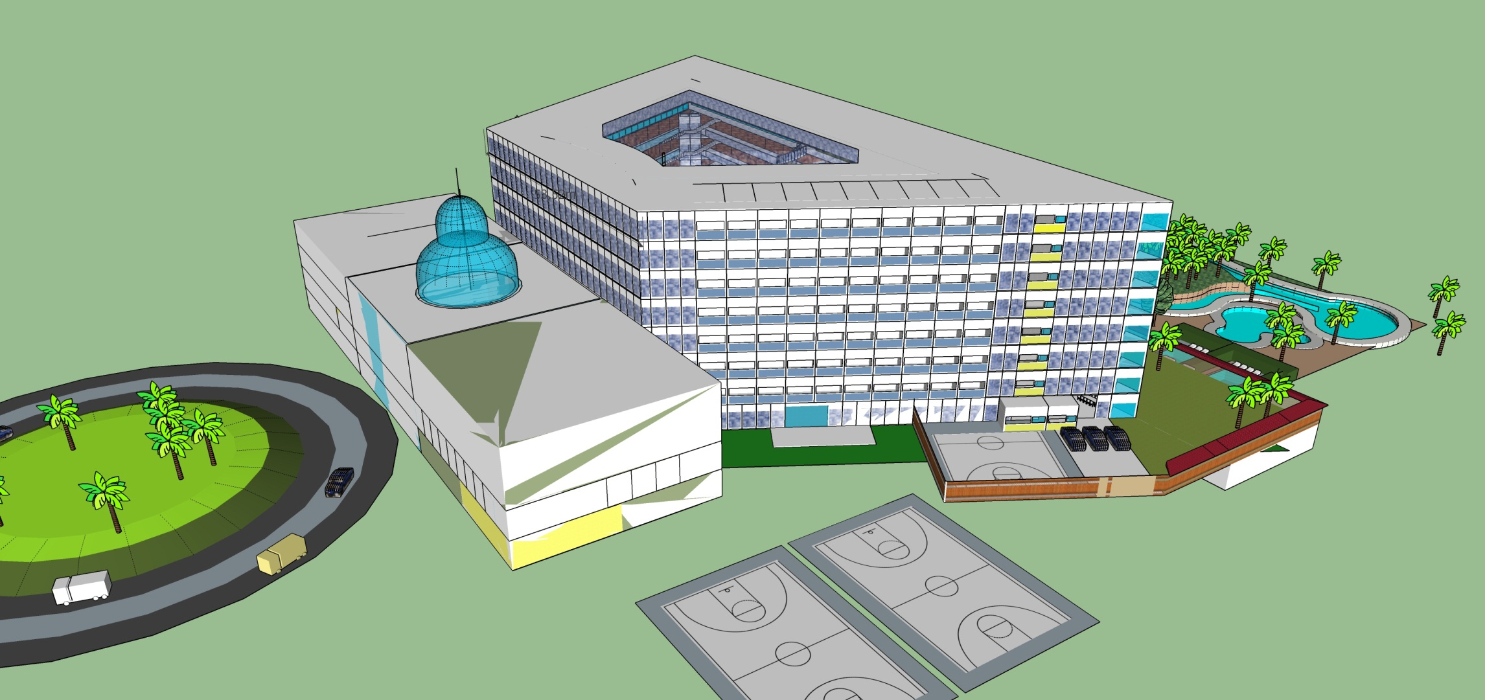
Ambassador Hotel: 219 rms, 1ha pool, sports, ball rooms, offices, McD, Buffet, 27 shops, kiosks

Slide 25
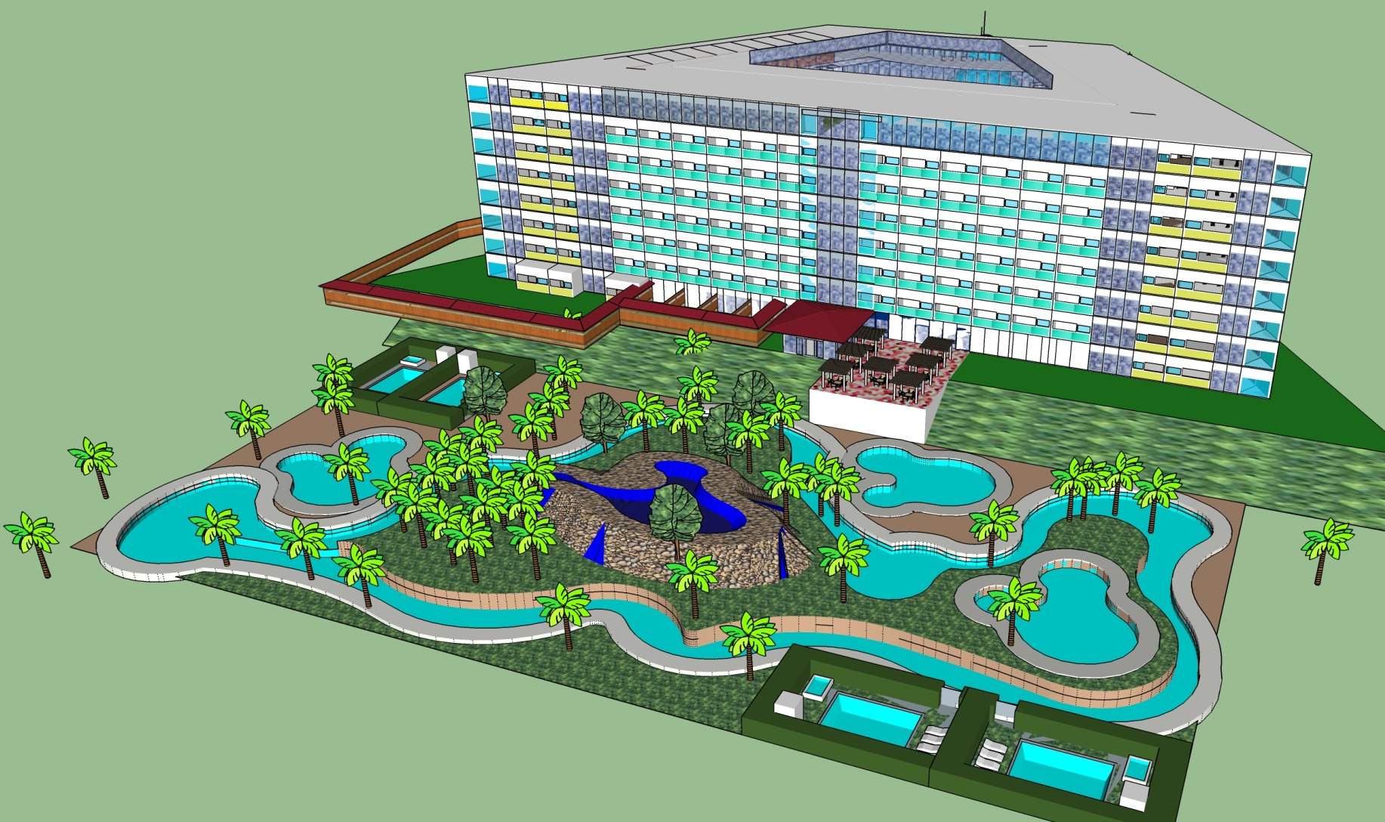
Trapezoidal 8/f Room Tower;
8+ restos, 5 LARGE function rms, SPA, theatre, studios, 8/f church

Slide 26
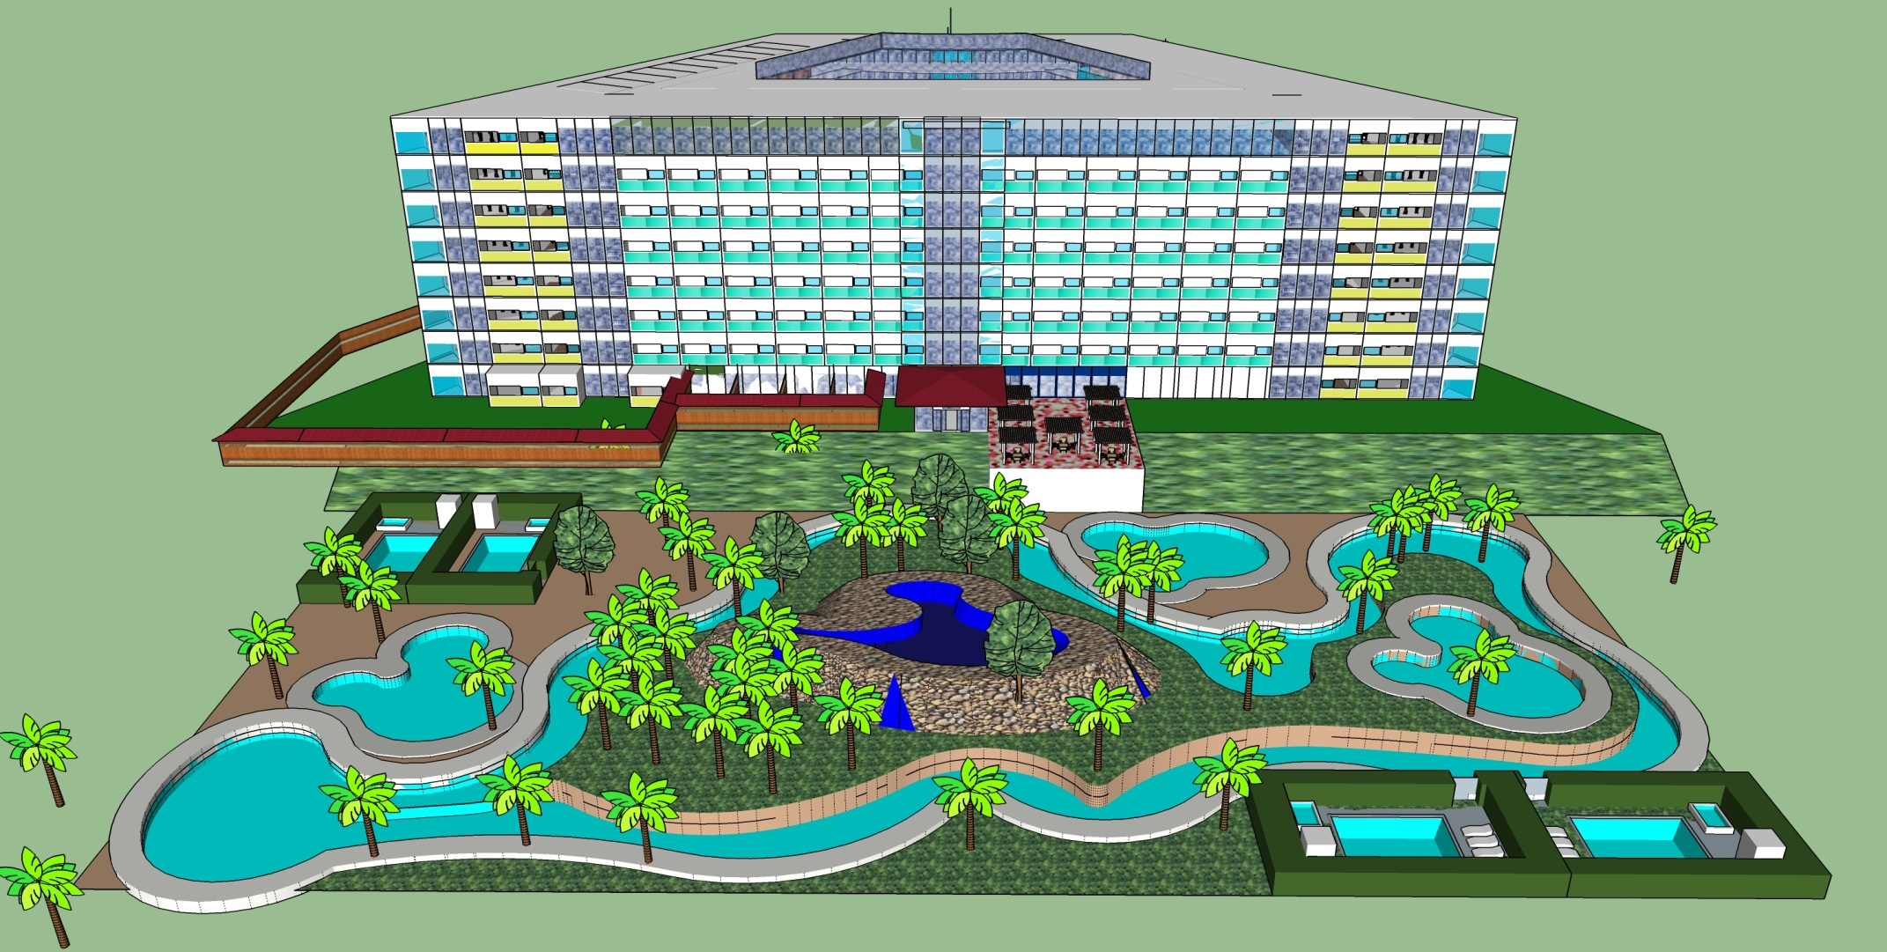
Long wall of guest rooms overlooks ocean and 1ha pool; also tennis, horses, archery, etc. kid activities

Slide 27
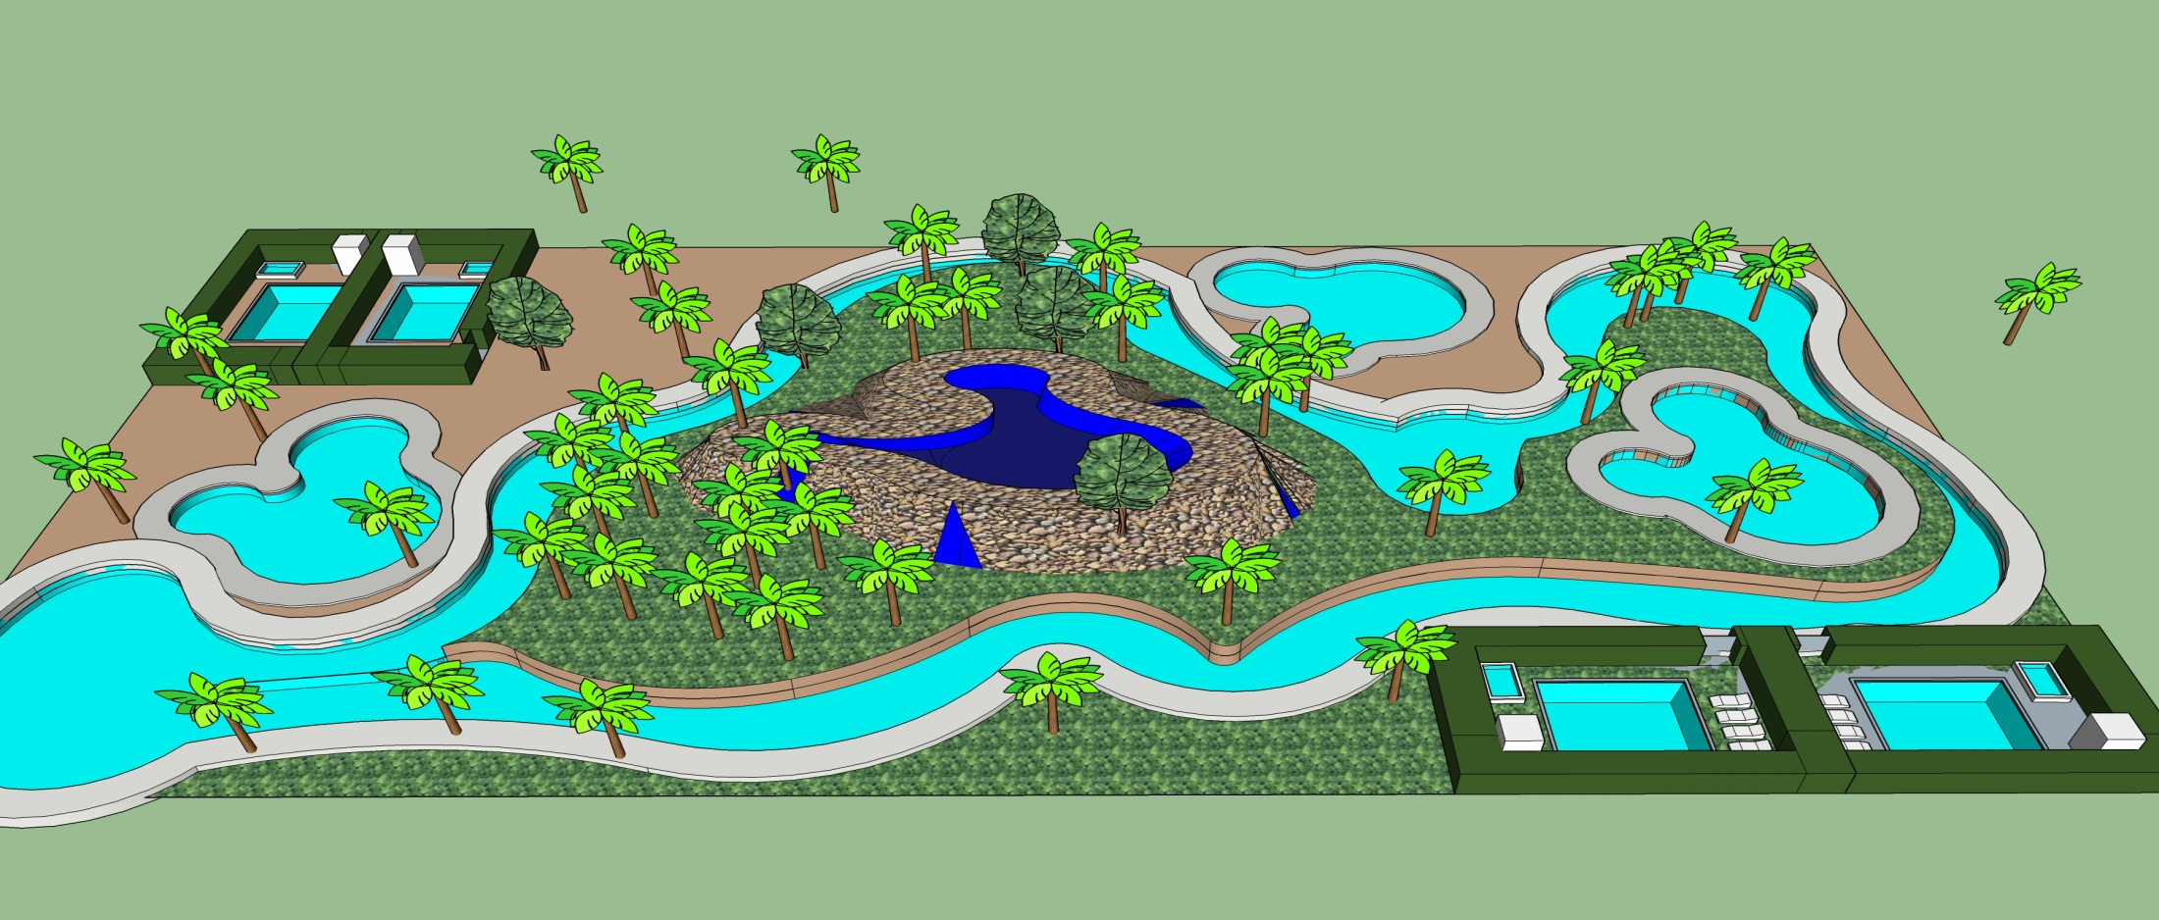
Outdoor Pool is like a waterpark; private pools, lazy river, spring hill

Slide 28
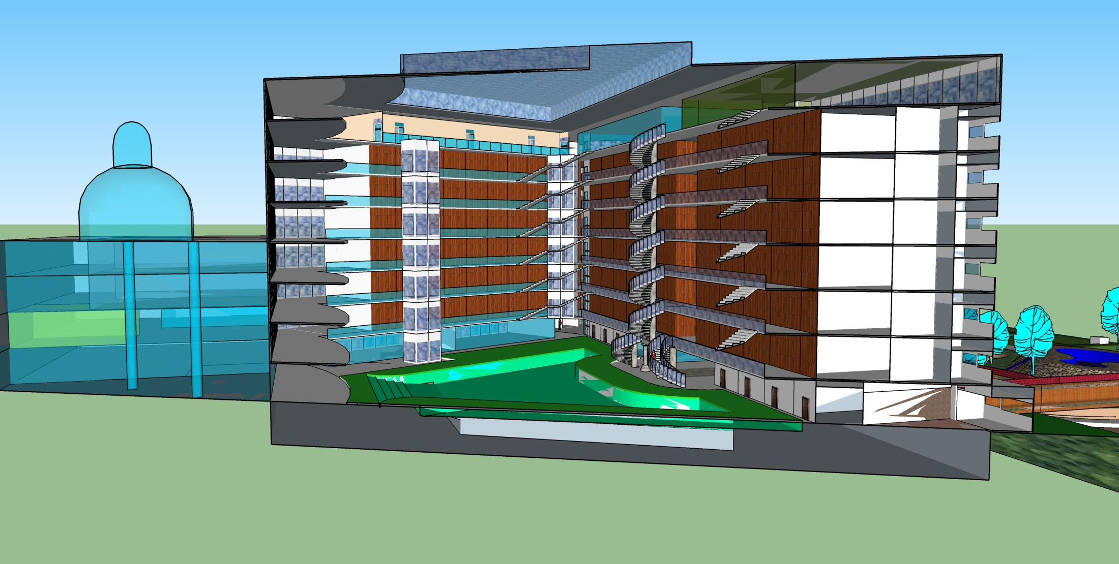
8/f Atrium inside tower indoor pool and restos inside

Slide 29
Planning Department
Due to complexity of next projects we need a team of architects, designers, city planners, etc to develop actionable plans ASAP
It takes years to plan some of these projects, but we have been working already for almost 10, so we have a good start.
Planning Department will need to start ASAP, as soon as we get funding; will get a place to work, drafting and printing equipment, etc.

Slide 30
Planning Department: main tasks
Theme Park at 220 ha+
New Town at 20-50ha;
Hotels, Restaurants, Sport Facilities,
Housing Development; Car Racing series
Children’s Village, Elderly Village, Pastor’s Center, Bohol Christian University (BCU)
Manufacturing; Media; Shipping; Horses
Ministry Center, Global Outreach Activities, Bible School & Equipping

Slide 31
New Town: Gloria
6 Blocks, God said
Round Central Area (2ha park), roads radiate out like rays of glory He said
Very close to theme park front gate
INCLUDES: Theaters, shopping, mall, entertainment block, Pavillion Condos, Messenger Campus, Civic Center, schools, housing, etc.

Slide 32
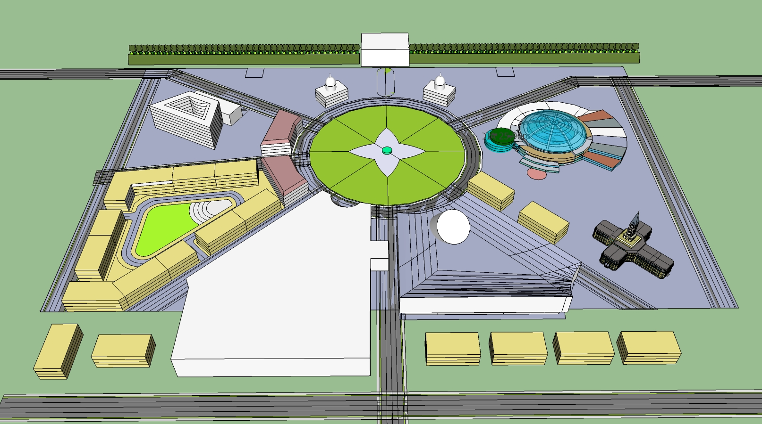
Gloria: early concept

Slide 33
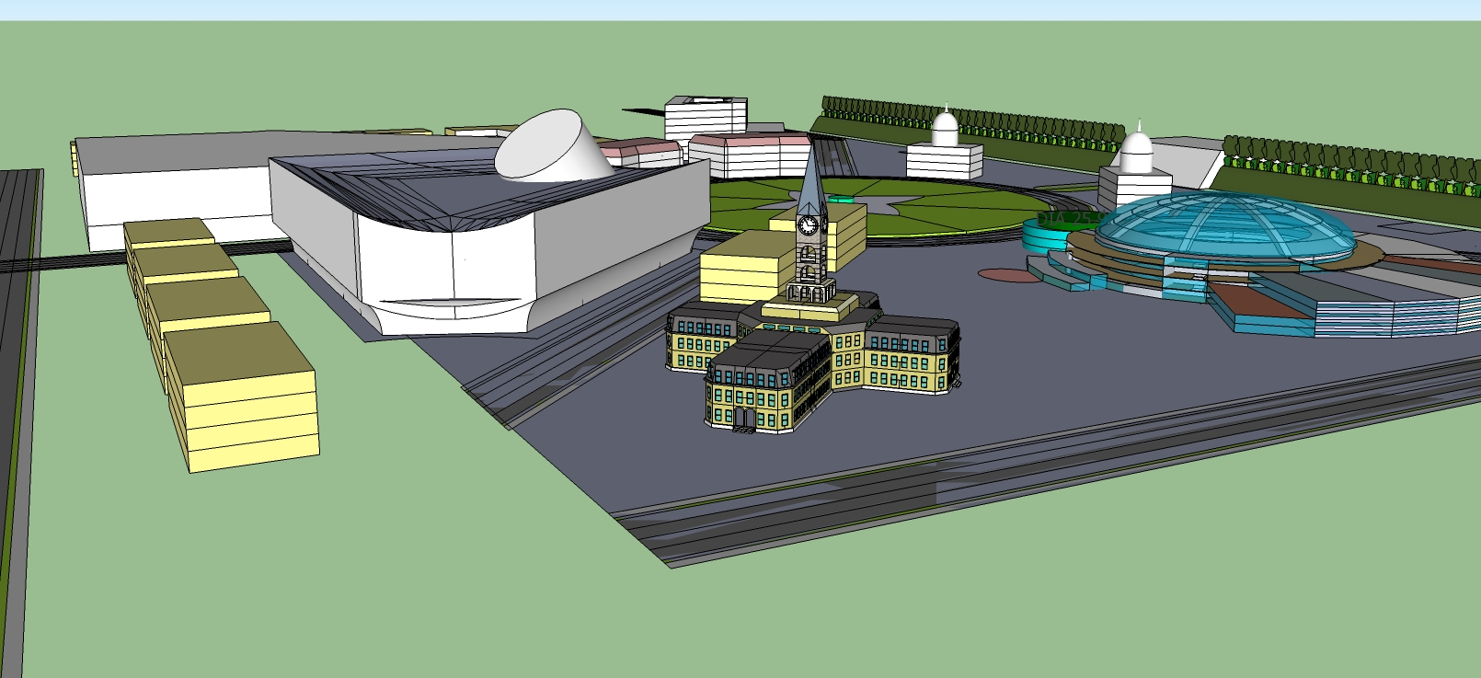
Gloria: BCU Admin, Civic, Messenger, Mall … looking towards Park Gate

Slide 34
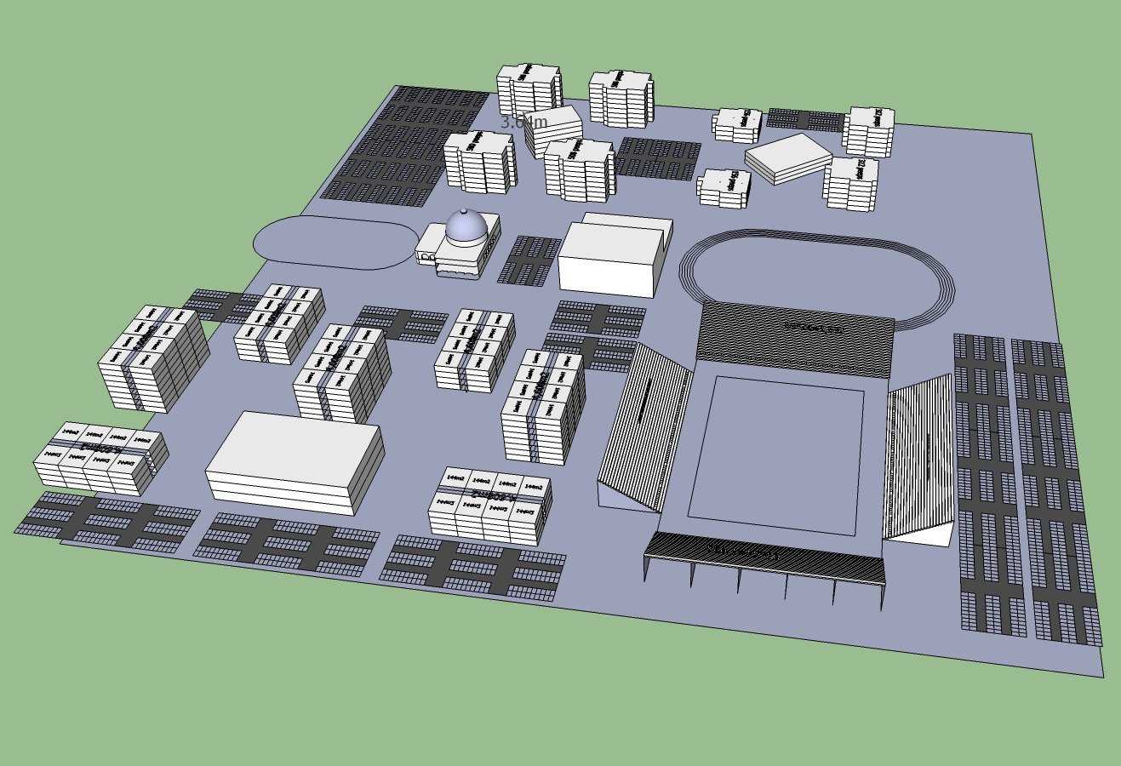
Gloria: BCU Campus & Sport Facilities

Slide 35
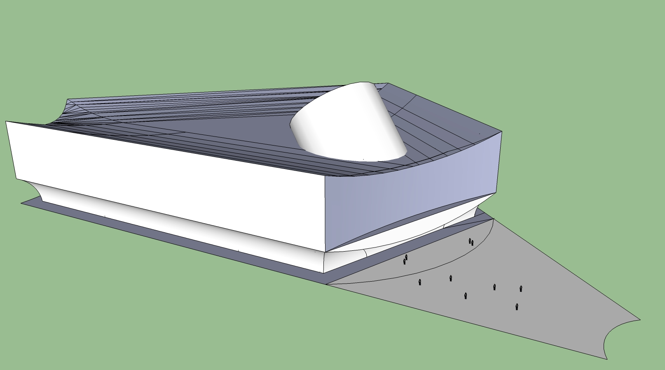
Gloria Civic Center:
(arts, music, library, etc.)

Slide 36
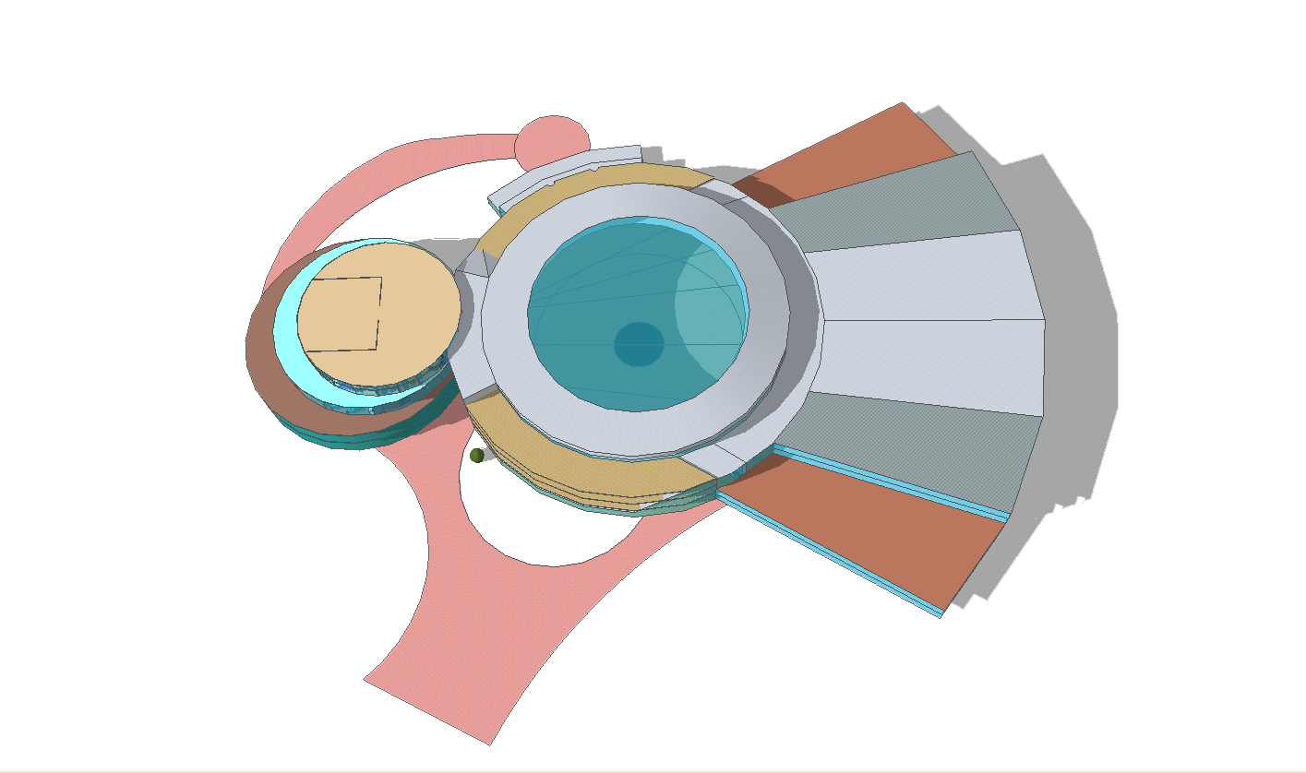
Gloria: PMB Campus
Global Ministry Hub

Slide 37
Gloria: Entertainment Quarter
Area near Main Entrance to Park
Entertainment Block with bazaar market, themed restos, mini-golf, etc.
Compare it to Downtown Disney or Disney Springs
Free admission area for night time entertainment
Students, Tourists, Staff, etc.

Slide 38
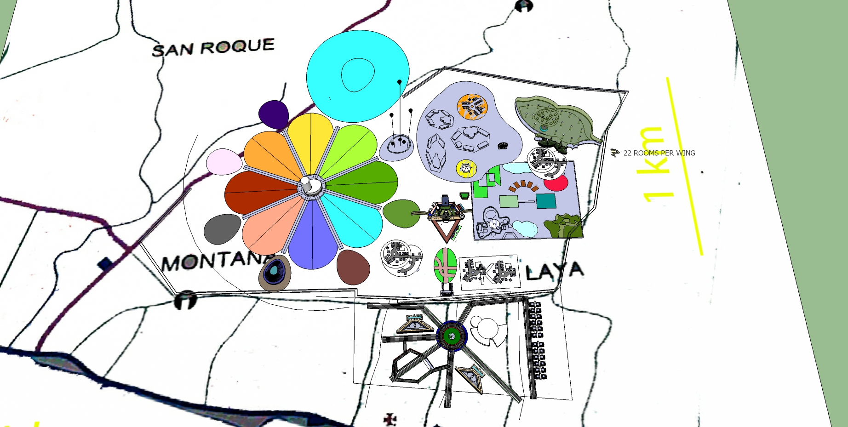

Slide 39
Sympatico Theme Park
Triangular Main Castle and two Palaces, German village, terraces, hotel, bazaar, etc.
Vase-like Crystal Castle and Grounds (50ha)
Children’s Castle (20ha)
Caribbean Dream Waterpark (30ha)
Flutterby Forest; 7 Villages in total
Untamer Gamer: Amusement Rides
30k visitors/day, 10k employees,
P7 billion revenue per year

Slide 40
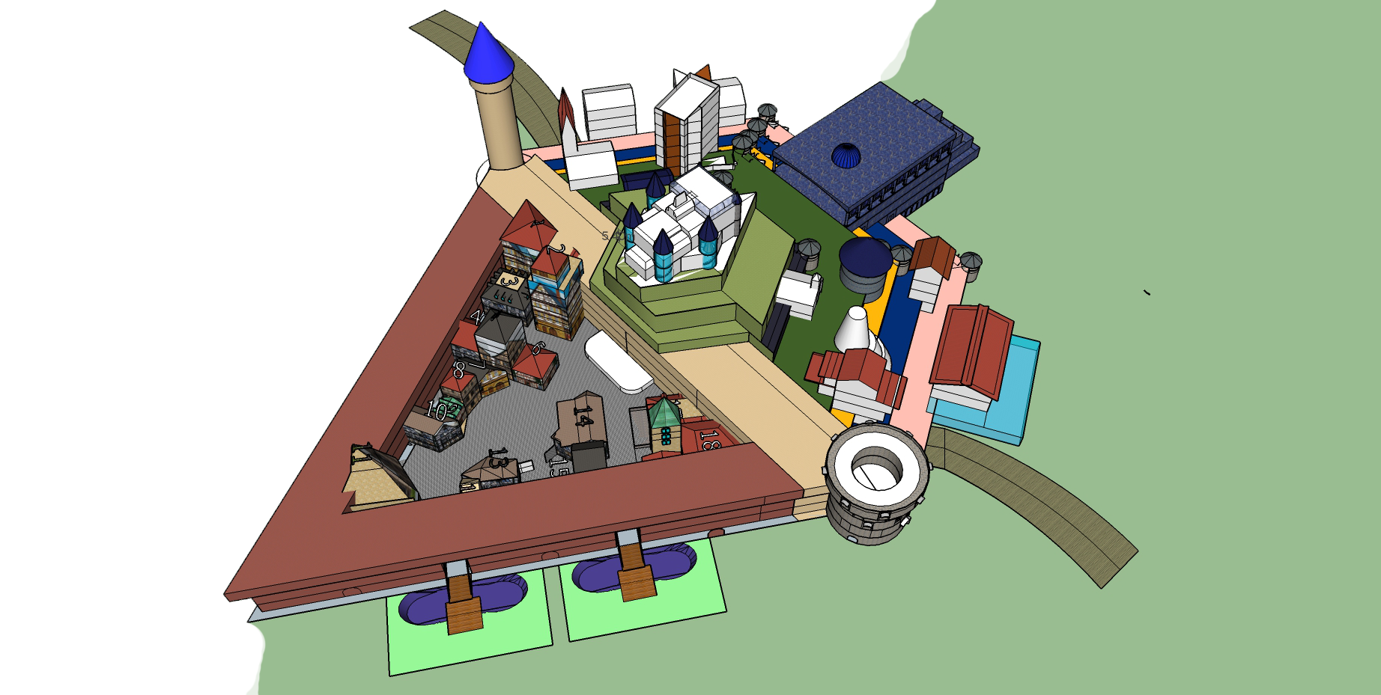
Sympatico Theme Park
Main Park Castle: three walls, two towers, two Palaces
Terraces with 11
buildings, 6 ha indoor
space in terraces alone
65 room boutique Hotel
2/f of shopping Bazaar
German Village
Worship Hall
Train Station

Slide 41
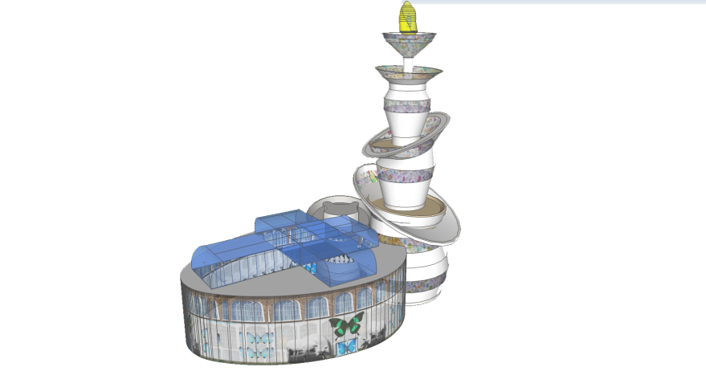
Sympatico Theme Park
Crystal Castle, white and steel, 100m tall, a “women’s” castle.
Surrounded by 8 themed Gardens with Aviary, English, African, Coral Seas (aquarium), Desert & Caves, Gorges and Waterfalls, Zoo, Formal French, etc.
300m away are 8 Themed Lands,
each with a major ride:
Space, Winter, Carnival
PWD, Jungle, Balloons,
Dinos, …
and full 20ha waterpark

Slide 42
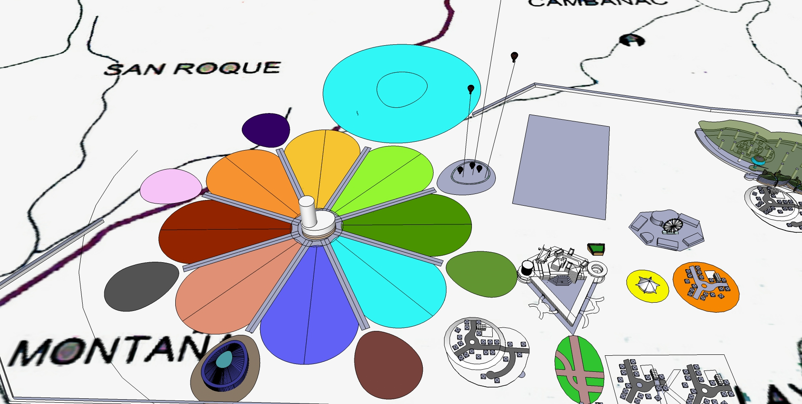
Crystal Castle Grounds: 8 Gardens, 8 Lands

Slide 43
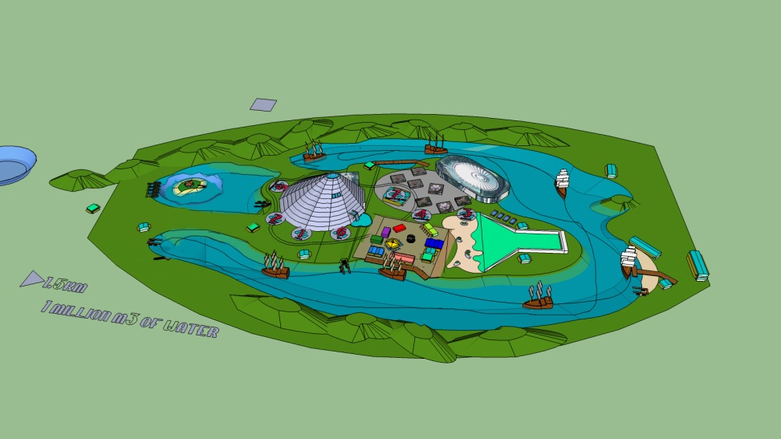
Caribbean Dream Water Park: 20 ha,
1m cubic m water, Volcano hotel, etc

Slide 44
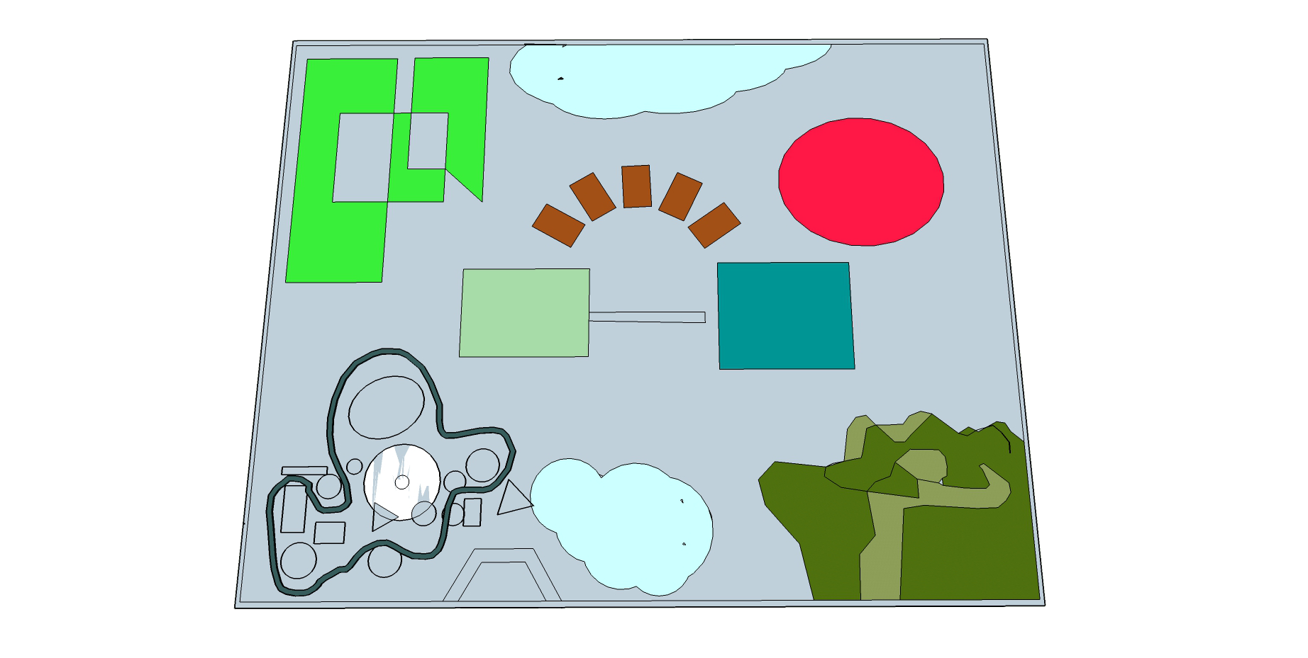
Children’s Castle: 20ha
20ha enclosed children’s play area, picnic site for 1,500 students, coach bus parking
Main Castle: food, maze, ball hall, thrones, dress up
Dark Ride: “Jesus Loves the Little Children”
Playground; Child-size
Amusement Rides area
‘Cannon Volley Ball’,
Miniature town;
Horses and stables
Hall of Wonders,
a science museum
Sprayground; Petting
Zoo, Dark Forest

Slide 45
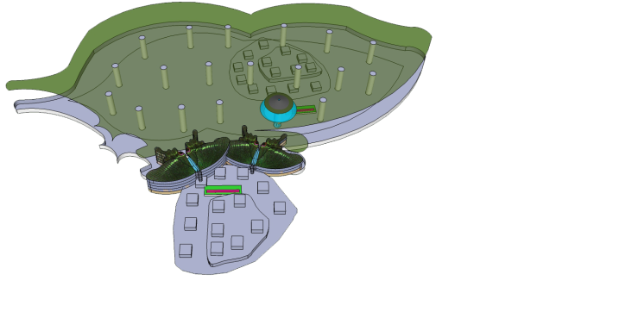
Flutterby Forest and Butterfly Hotel
7ha enclosed forest under canopy 100ft tall
Butterfly and bird habitat, canopy walk
Tree top 5-star restaurant, the Swallowtail
Paris Peacock
Butterfly Themed Hotel,
Themed Tourist Village

Slide 46
Sympatico Theme Park
“Untamer Gamer” hard core amusement area with Asia’s largest roller coaster, Ferris wheel, Basketball Challenge,
Laser Tag, VRRC, etc.
7 inhabited villages with residents, B&B’s
Trains, horse and carriages, e-vehicles
30+ restos, souvenir shops, roaming entertainers, jugglers, parades, seasonal
4,000 hotel rms; up to 10,000 employees

Slide 47
Maybe need 20,000 workers to build,
10,000 to run the park in many roles:
Gardens and grounds, trees to flowers
Animals: elephants, horses, fish, etc.
Hawkers and entertainers, souvenirs and gifts, actors, jugglers, security, IT
Singers, musicians, dancers, ride operators
Engineers, designers, maintenance
Administrators, accounting, purchasing, manufacturing, cooks, janitors, tours, hotels

Slide 48
Hotels – 4,000 rooms
Ambassador is smallest at 219 rooms
Nextus: 5 star, modern, 1,200 rooms
Boardwalk: mid range, fun, 1,800 rooms
Chamberlain: family royal theme, 800 rms
Sympatico Morning Palace: 65 rooms
in main castle overlooking plaza
Paris Peacock Butterfly Hotel:
350 rooms part of Flutterby Forest
B&B etc. in various places 250 rooms

Slide 49
Restaurants
Jesus said, Pizza
You’ll have a resto called Fire by Night
50+ restaurants in Park, New Town, etc.
Food service can be partly centralized
Will may need to grow much of what we need to cook or sell, need herbs, chicken, beef, etc.

Slide 50
Sport Facilities
10,000 seat Stadium, may be a part of BCU , great event venue
He said, Don’t have a concert until the infrastructure is ready
Basket Ball, soccer, concerts, etc.
Pools, weights, tennis, horses. etc.
Olympics and Asian game training capability

Slide 51
Car Racing!!
Actually OUR LAST project, He said.
EVERYONE will come to a race, can reach everyone with urgent minstry.
Bohol has main road track in Payahan.
Will start with 24 hour race. Can have
7 tracks across Philippines.
Series will make rock stars from racers, we will produce reality show from racers, will take over TV in Phils. Wow

Slide 52
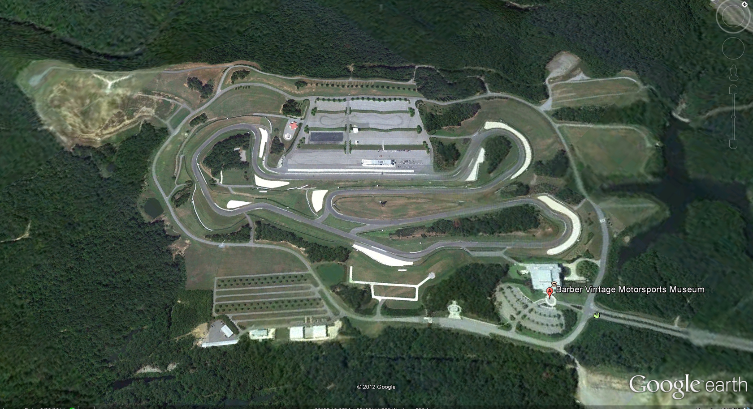
Barber Motorsports Park, Alabama: a model for our Bohol track

Slide 53
Housing Development
50 Luxury Houses Jesus said
Average price P7m, he added
In Vision it looked like where I grew up, American Style, not Asian
150m² average size, up to 250m², as long as we keep within average cost range
Large yards (1,000+m²), wide roads, sidewalks, American suburban, club house?
Start AS SOON AS I FIND THE LAND!

Slide 54
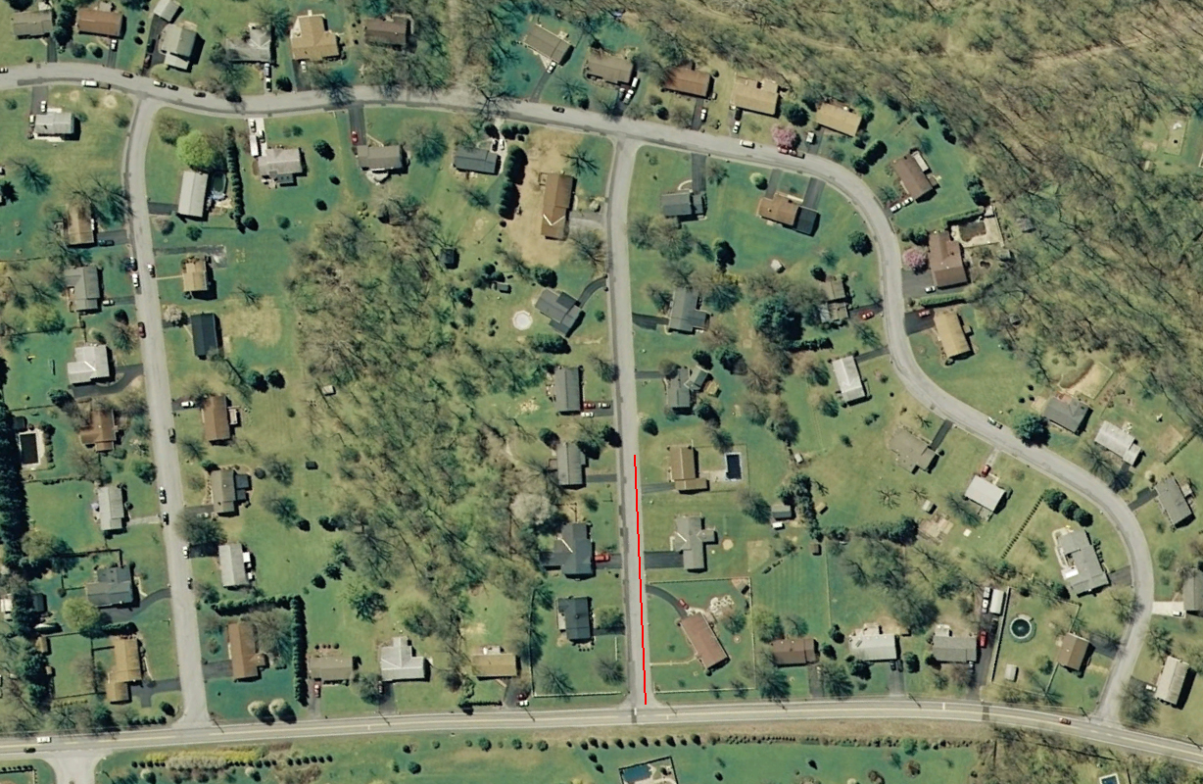
Lexington Drive, Pennsylvania

Slide 55
Large Scale Charity Projects
A Orphanage or Children’s village of 100ha
An Elderly Care Village, also 100ha
Pastor Support Network and Resource Center
Other activities as called

Slide 56
Children’s Village
A Charity / orphanage village of 100ha
May have up to 10,000 children, so will need up to 1,200 houses, prefabrication method can build 10 /day.
Hard to understand how to administer this
Will have town center, police, admin, cafeteria, security, schools, play ground, food production
Idea will become famous, attract money from families, international, government, and businesses Jesus said

Slide 57
Golden Days Care
Elderly Care Facility, also up to 10,000 residents on 100ha;
Jesus said he’s planned for these people to live here since before they were born
Provides entertainment, nursing, food (diets for all for medical issues), social activity, family visits, and especially MINISTRY for salvation for everyone
Will be close by, (Libertad?) Can combine with Children’s village somehow

Slide 58
Shepherd’s Haven, Pastor’s Center
Shepherd’s Haven is a resource center
Land we get will be a funny ‘L’ shape
Restaurant, Library, function rooms, grocery store, vehicle repair, P5k cash allowance every month, etc. Social venue for pastors.
Guest house but not too large, only 12 floors with 2 rooms per floor I think, 24 rooms only
A way to empower, train and support pastors
If pastors don’t join our network they will BE LEFT BEHIND, Jesus said, we must be shrewd! To bring in as many as we can. (Get Spirit Filled)

Slide 59
Bohol Christian University (BCU)
Elect School He said, not an international school but we choose who goes there
We pay all fees “…you can afford it”
Can build UB … in 6 months
Will train people to work in park, in government, in engineering, medicine, IT, … and ministry. Maybe like Park training?
Everyone can be baptized in Holy Spirit, and learn prophecy, etc.

Slide 60
Manufacturing
God keeps asking, “What do you want to manufacture??!!” WOW!
He specifically mentioned
  Toys (because they always break)
  Pianos (not guitars)
  Submarines! Seriously!
  Food, all kinds
  Construction
  Money (a mint, make coins etc)

Slide 61
Media … ALL Media
My background is in magazines
God said called to ALL media:
  Movies, TV, youtube series, advertising
  Radio, I saw Bach classical but also need Christian here locally.
  Music production to make bands, tours, CDs, DVDs
  Web, apps, and games
  Print, Newspapers, magazines, books

Slide 62
Shipping
Global Shipping fleet, he said
No idea what it means,
Cargo of any type
But global rescue operations for refugees too?

Slide 63
Horses: Ambrose Equestrian
God spoke a lot about this.
Will import Gypsy horses to form local herd. It will be symbol of the Theme Park and Bohol tourism in general. Very cool
Will make horse carriages, use in the park, for weddings, parades, etc.
Will have remote ranches to ride to, camp in, and be an extension of the park.
One of the most beautiful animals on earth!

Slide 64
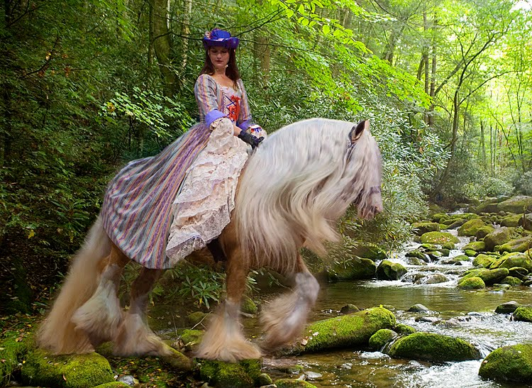

Slide 65
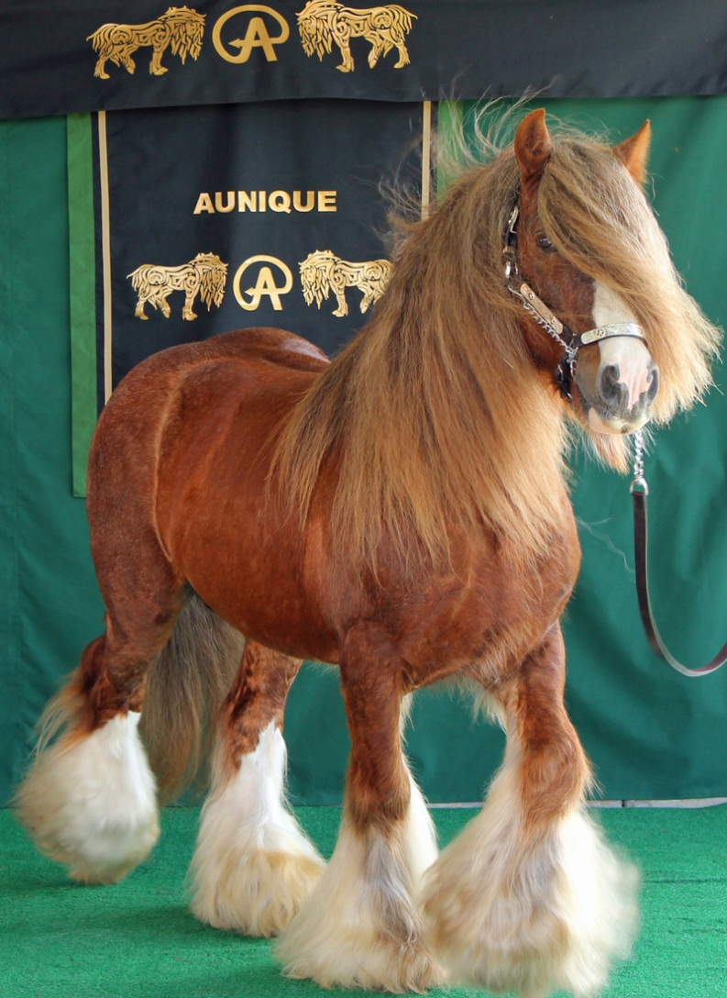
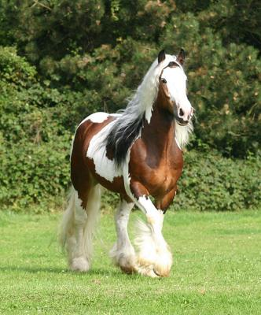

Slide 66
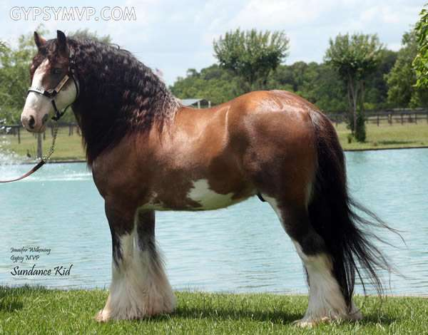

Slide 67
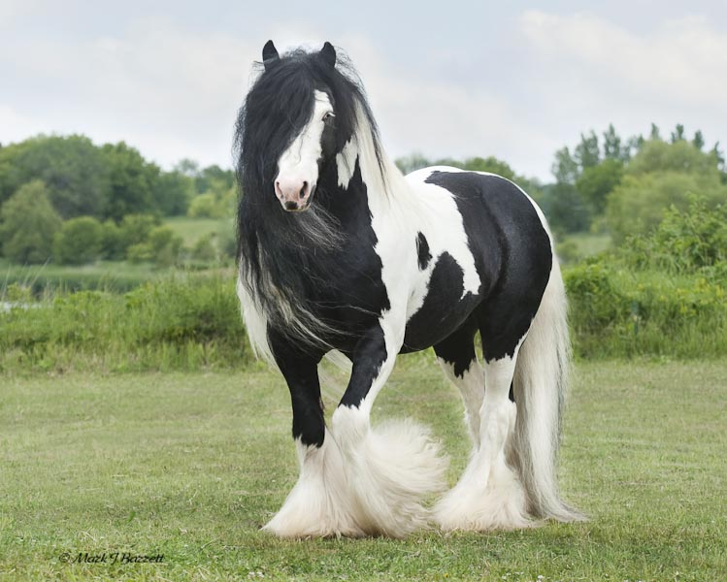

Slide 68
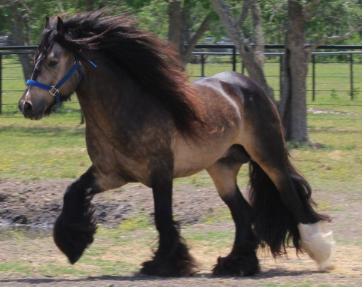

Slide 69
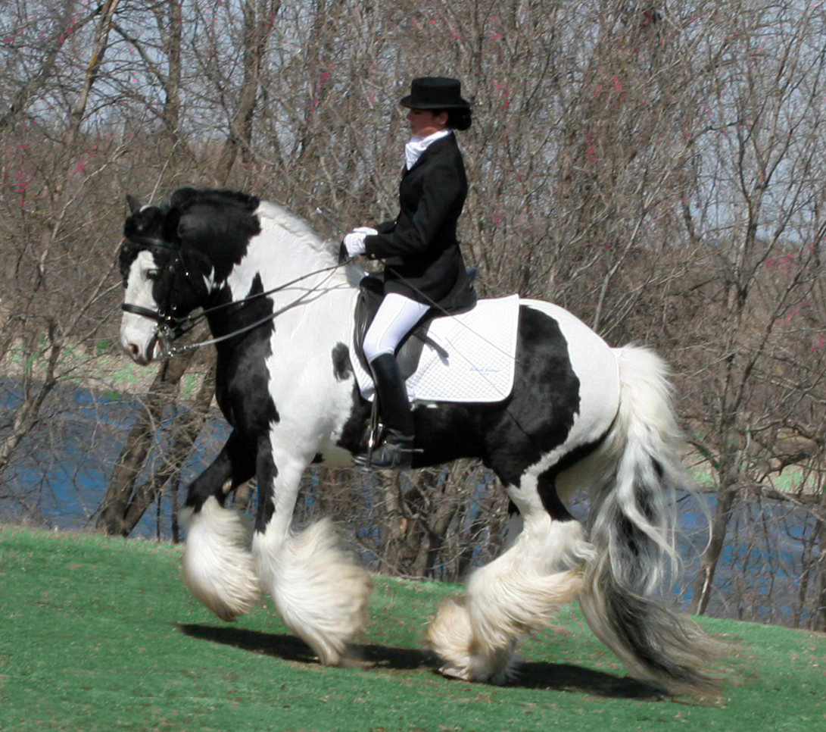

Slide 70
PMB Campus
Ministry Center and Headquarters of Global Ministry, Bible school, Training, etc
He said, “Now make me something! Make me this campus. Make it for 50 Staff … but soon more people will come than you can fit in a building.”
So we made
this design,
the Messenger
Has classrooms,
cafeteria, library,
offices, worship, etc.

Slide 71
PMB Campus
Global Outreach: Africa, India, Indonesia, USA … He said it will go all over the earth
He said the key … is the bible school.
Said to Train the prophets.
Teach the message he gave me, of the Foundations of the Kingdom
The Revival will make history, be legendary
The burden of the ministry will be too big for me he said. I will need to recruit a lot of help, intercession, prophets

Slide 72

God … it’s too much!
He said … “I know, that why I made the vision SMALLER” and I saw fields of wheat, real wheat, being harvested by an American Combine Harvester … wow, can we still do that? Turn Bohol into a breadbasket? Maybe it’s someone else’s job now.
But maybe that was a symbol of evangelism too, I don’t know

Slide 73
A God-Sized Vision
These projects, even the smallest, are bigger than I dreamed I could ever do.
Any one of these projects is a man’s life work. He gave more than 30!
God’s glory will be evident by the sheer size of the task accomplished by people like us, outsiders, no debt, no corruption … it will be a wonder to the world who seek after these things that we were given them, who didn’t want them

Slide 74
Needed
Vision Elders, prayer, guidance
Ministry, Bible school, Seminars
Planning, design, architecture,
Fish breeding, construction
Also young people to be trained to be minsters to heal and prophesy
Prayer team, but it will be a hard ask
Temptations for pride and greed are real must be overcome!

Slide 75
Questions?
When do we start?
  We already have
  Preparing for investment; keeping very busy meanwhile designing, writing
  Ministry is main goal, taking care of kids, training people in the kingdom, work on bible school, writing books
  Need to prepare for investment, it’s a small amount actually in Hong Kong.
  God said it is coming. We need to prepare to start farm.

Slide 76
Questions?
When do we start?
  Planning Department? Now! Need to find people with talent and time to help plan.
  Who wants to help? What can they do?
  Each project has its own details to iron out
  Fish Farm planning is done, Theme Park planning is advanced, New Town also … but not done
  Eg., BCU needs administration framework, Ambassador Hotel needs interior design
  So many things to do, prioritize by timeline

Slide 77
Prophetic Guidance
God gives the vision
God clarifies the direction
God does not give all the details, we must do our planning, but be ready for God to adjust it.
If God speaks GENERAL INFO, we fill in specific details
If God gives specific details, we fill in general info.
Pray for insight, God will release it

Slide 78
Next: Bethsaida Specifics
Next info to share is Specific Bethsaida Details and planning
Plan is done, we will encounter new issues later and have to overcome them as they arise.
I am praying to start ASAP

Slide 79
Do you want to help?
If you want to help … pray, understand your role, but also your desire
Learn about what we have already heard God say
Learn what we have already planned, let’s focus on first steps, and also large projects that need more manpower
Prayer meetings, prophesying, etc., is always a good idea

Slide 80
Glory to God! and
Amen!

